Slide 1
JavaScript & Node.js
Olivier Liechti & Simon Oulevay
COMEM Web Services 2016

Slide 2

Quick Poll

Slide 3
Quick Poll
What is your current perception of JavaScript?
Scope
  It's a "toy" language for creating animations on web pages, but I would not use it for anything "serious".
  It's a very powerful language. It is essential on the client side, but it is also really interesting on the server side.

Slide 4
Quick Poll
What is your current perception of JavaScript?
Personal taste
    I hate it.
    I am not a big fan.
    It's kind of interesting.
    I love it.
    I don't care.

Slide 5
Quick Poll
What is your current perception of JavaScript?
Relationship to Java
  It's Java, with a few syntactic differences.
  It has nothing to do with Java, except for some common syntax.

Slide 6
Quick Poll
What is your current perception of JavaScript?
Current knowledge
  Novice: I may have hacked a few scripts on web pages, but mostly by copy-pasting examples and without fully understanding the language (what is a prototype?).
  Intermediate: I have used JavaScript quite a bit. I can describe the object-oriented model, I understand what a constructor is and how it works. I have quite a bit of experience with JQuery and other libraries. I am always working with a debugger.
  Expert: closures and modules have no secret for me, I have read "JavaScript: the good parts". I have designed my development workflow with yeoman, grunt, bower and a few other tools. I know who Paul Irish is.

Slide 7

Douglas Crockford:
JavaScript: The Good Parts
https://www.youtube.com/watch?v=_DKkVvOt6dk

Slide 8
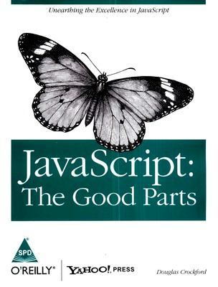
JavaScript is built on some very good ideas and a few very bad ones.
JavaScript is an important language because it is the language of the web browser. Its association with the browser makes it one of the most popular programming languages in the world. At the same time, it is one of the most despised programming languages in the world. […]
Most people in that situation don’t even bother to learn JavaScript first, and then they are surprised when JavaScript turns out to have significant differences from the some other language they would rather be using, and that those differences matter.
The amazing thing about JavaScript is that it is possible to get work done with it without knowing much about the language, or even knowing much about programming. It is a language with enormous expressive power. It is even better when you know what you’re doing. Programming is difficult business. It should never be undertaken in ignorance.

Slide 9
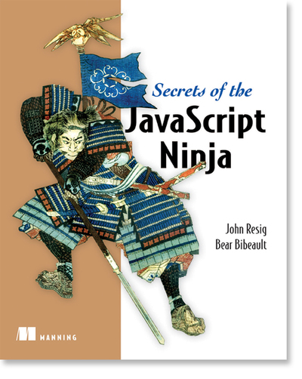
JavaScript is important. That wasn’t always so, but it’s true now.
Web applications are expected to give users a rich user interface experience, and without JavaScript, you might as well just be showing pictures of kittens. More than ever, web developers need to have a sound grasp of the language that brings life to web applications.
And like orange juice and breakfast, JavaScript isn’t just for browsers anymore. The language has knocked down the walls of the browser and is being used on the server in engines such as Rhino and V8, and in frameworks like Node.js.
Although this book is primarily focused on JavaScript for web applications, the fundamentals of the language presented in part 2 of this book are applicable across the board.
With more and more developers using JavaScript, it’s now more important than ever that they grasp its fundamentals, so that they can become true ninjas of the language.

Slide 10
JavaScript 101

Slide 11
Rule #1
JavaScript defines 6 types
var aNumber = 3.12;
var aBoolean = true;
var aString = "HEIG-VD";
var anObject = {
aProperty: null
};
// t is true for all of these:
var t;
t = typeof aNumber === "number";
t = typeof aBoolean === "boolean";
t = typeof aString === "string";
t = typeof anObject === "object";
t = typeof anObject.aProperty === "object";
t = typeof anObject.foo === "undefined";
The 6 types are:
  number
  boolean
  string
  object
  undefined
  null
null is a type, but typeof null === object.

Slide 12
Rule #2
JavaScript is a dynamic language
var myVariable = "aString";
typeof myVariable; // "string"
myVariable = 3.12;
typeof myVariable; // "number"
myVariable = true;
typeof myVariable; // "boolean"
myVariable = {
aProperty: "aValue"
};
typeof myVariable; // "object"
When you declare a variable, you don't specify a type.
The type can change over time.

Slide 13
Rule #3
There are 2 scopes for variables:
the (evil) global scope and the function scope
var aVariableInGlobalScope;
function myFunction() {
var aVariableInFunctionScope;
anotherVariableInGlobalScope;
}
function myFunction2() {
for (i = 0; i < 10; i++) {
// i is in global scope!
}
for (var j = 0; j < 10; j++) {
// j is in function scope!
}
}
A variable declared within a function is not accessible outside this function.
Unless using strict mode, it is not mandatory to declare variables (beware of typos…)
Two scripts loaded from the same HTML page share the same global scope (beware of conflicts…).
There is no block scope.

Slide 14
Rule #4
JavaScript supports first-class functions
function multiplyByTwo(n) {
return n * 2;
}
multiplyByTwo(3); // 6
var hello = function(name) {
console.log("Hello " + name + "!");
};
hello("World"); // "Hello World!"
function applyToArray(array, func) {
for (int i = 0; i < array.length; i++) {
array[i] = func(array[i]);
}
}
var a = [ 1, 2, 3 ];
applyToArray(a, multiplyByTwo);
console.log(a); // [ 2, 4, 6 ]
New functions can be defined at runtime.
Functions can be stored in data structures.
Functions can be passed as arguments to other functions.

Slide 15
Rule #5
Objects are dynamic bags of properties
// let's create an object
var person = {
firstName: 'olivier',
lastName: 'liechti'
};
// we can dynamically add properties
person.gender = 'male';
person['zip'] = 1446;
// and delete them
delete person.zip;
for (var key in person) {
console.log(key + " : " + person[key]);
};
There are different ways to access properties of an object.
JavaScript is dynamic: it is possible to add and remove properties to an object at any time.
Every object has a different list of properties (no class).

Slide 16
Rule #6
Arrays are objects
var fruits = ["apple", "pear"];
fruits.push("banana");
typeof fruits; // "object"
for (var i = 0; i < fruits.length; i++) {
console.log("fruits[" + i + "] = " + fruits[i]);
}
var transformedFruits = fruits.map( function(fruit) {
return fruit.toUpperCase();
});
transformedFruits.forEach( function(fruit) {
console.log(fruit);
});

Slide 17
Rule #7
The language has no support for classes
There are 3 ways to create objects
class is a reserved word in JavaScript, but it is not used in the current version of the language (reserved for the future).
A constructor is function like any other (uppercase is a coding convention).
It is the use of the new keyword that triggers the object creation process.
// create an object with a literal
var person = {
firstName: "olivier",
lastName: "liechti"
};
// create an object with a prototype
var child = Object.create(person);
// create an object with a constructor
var child = new Person("olivier", "liechti");

Slide 18
Rule #8
Every object inherits from a prototype object
var person = {
firstName: "olivier",
lastName: "liechti"
};
// person’s prototype is Object.prototype
var father = {};
var child = Object.create(father);
// child’s prototype is father
function Person(fn, ln) {
this.firstName = fn;
this.lastName = ln;
}
var john = new Person("John", "Doe");
// john’s prototype is Person.prototype

Slide 19
Rule #5
Every object inherits from a prototype object
prototype
prototype
Object.prototype
father
child
firstName : ‘olivier’
lastName : ‘liechti’
firstName : ‘sacha’
Every object inherits from a prototype object. It inherits and can override its properties, including its methods.
Objects created with object literals inherit from Object.prototype.
When you access the property of an object, JavaScript looks up the prototype chain until it finds an ancestor that has a value for this property.
console.log(child.lastName);
// prints ‘liechti’ on the console

Slide 20
Rule #6
With patterns, it is possible to implement
class-like data structures
badGreet is a property that will be replicated for every object created with the Person constructor:
  poor memory management
  not possible to alter behavior of all instances at once
greet is a property that will be shared by all instances (because it will be looked up along the object inheritance chain).
privateVar is not accessible outside of the constructor.
fistName is publicly accessible (no encapsulation).
function Person(fn, ln) {
var privateVar;
this.firstName = fn;
this.lastName = ln;
this.badGreet = function() {
console.log("Hi " + this.firstName);
};
};
Person.prototype.greet = function() {
console.log("Hey " + this.firstName);
};
var p1 = new Person("olivier", "liechti");
p1.badGreet(); // "Hi olivier"
p1.greet(); // "Hey olivier"

Slide 21
JavaScript resources
A re-introduction to JavaScript
  https://developer.mozilla.org/en-US/docs/Web/JavaScript/A_re-introduction_to_JavaScript
Inheritance and the prototype chain
  https://developer.mozilla.org/en-US/docs/Web/JavaScript/Guide/Inheritance_and_the_prototype_chain
Introduction to Object-Oriented JavaScript
  https://developer.mozilla.org/en-US/docs/Web/JavaScript/Introduction_to_Object-Oriented_JavaScript

Slide 22
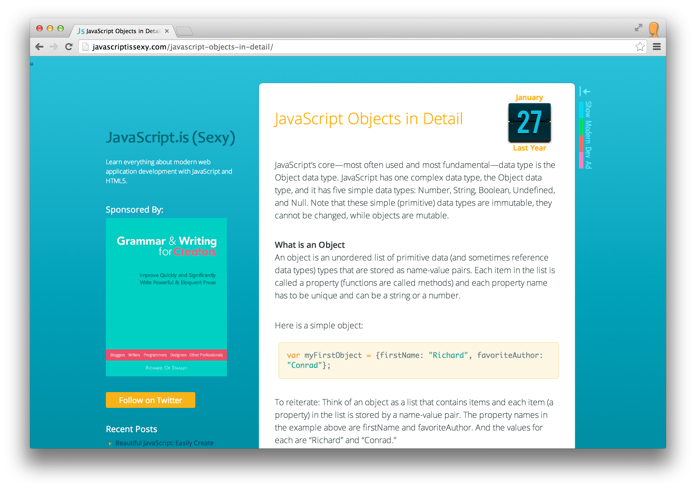

Slide 23

Node.js

Slide 24

“Node.js is a platform built on Chrome's JavaScript runtime for easily building fast, scalable network applications.
Node.js uses an event-driven, non-blocking I/O model that makes it lightweight and efficient, perfect for data-intensive real-time applications that run across distributed devices.”
not only!

Slide 25

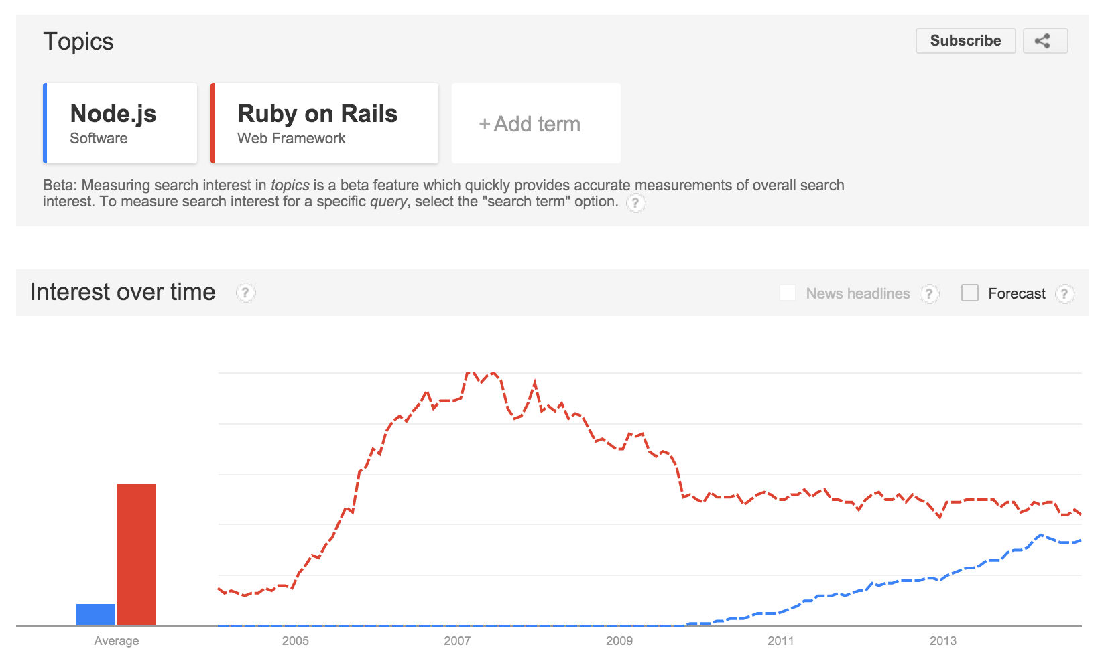

Slide 26
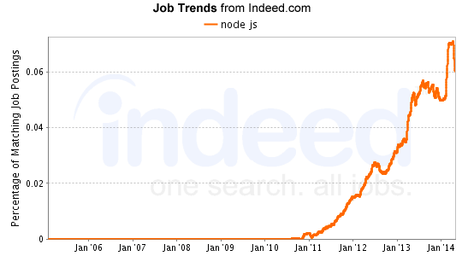
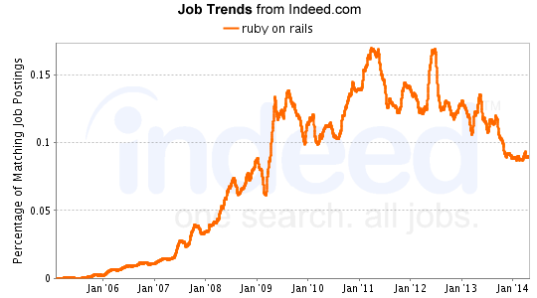

Slide 27
Single-threaded
Asynchronous
“I am not leaving until you are done...”
vs
“Wake me up when you have result”

Slide 28



Let’s look at a synchronous example
var fs = require("fs");
/**
* Simple function to test the synchronous readFileSync function of Node.js
* @param {string} filename - the file to read
*/
function testSyncRead(filename) {
console.log("I am about to read a file: " + filename);
var data = fs.readFileSync(filename);
console.log("I have read " + data.length + " bytes (synchronously).");
console.log("I am done.");
}
// We get the file name from the argument passed on the command line
var filename = process.argv[2];
console.log("\nTesting the synchronous call");
testSyncRead(filename);
We use a standard Node module for accessing the file system
fs.readFileSync is synchronous: it blocks the main thread until the data is available.
$ node sample2.js medium.txt
Testing the synchronous call
I am about to read a file: medium.txt
I have read 1024 bytes (synchronously).
I am done.
Synchronous functions are easier to use, but they have severe performance implications!!

Slide 29
Let’s look at an asynchronous example
var fs = require("fs");
/**
* Simple function to test the asynchronous readFile function of Node.js
* @param {string} filename - the file to read
*/
function testAsyncRead(filename) {
console.log("I am about to read a file: " + filename);
fs.readFile(filename, function (err, data) {
console.log("Nodes just told me that I have read the file.”);
});
console.log("I am done. Am I?");
}
// We get the file name from the argument passed on the command line
var filename = process.argv[2];
console.log("\nTesting the asynchronous call");
testAsyncRead(filename);
fs.readFile is asynchronous: it does not block the main thread until the data is available.
We must provide a callback function, which Node.js will invoke when the data is available.
Problems can happen when an (asynchronous) function is called.
$ node sample2.js medium.txt
Testing the asynchronous call
I am about to read a file: medium.txt
I am done. Am I?
Nodes just told me that I have read the file.
Node.js developers have to learn the asynchronous programming style.

Slide 30
Node.js callback convention
When calling an asynchronous operation, the convention in Node.js is to use a callback function that will be called with 2 arguments. If an error occurs, the first argument will be an error describing the problem. If the operation succeeds, the second argument will be the result. You will only receive one or the other, not both.
The callback function with its two arguments.
var fs = require("fs");
fs.readFile(filename, function (err, data) {
if (err) {
// handle the error
console.warn("An error occurred: " + err.message);
return;
}
// do something with the data
process(data)
});
Before doing anything with the data, check if there is an error.
If there was an error, handle it and stop there. There is no data available.
Otherwise, if there was no error, you may use the data.

Slide 31
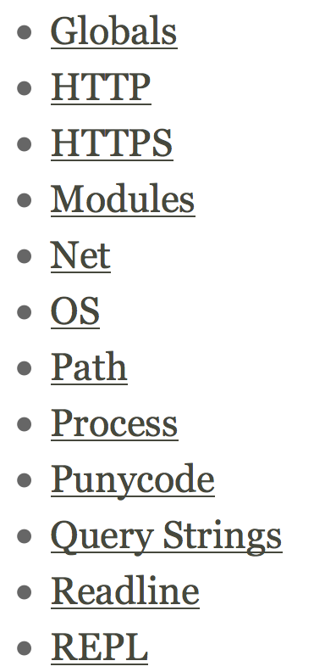
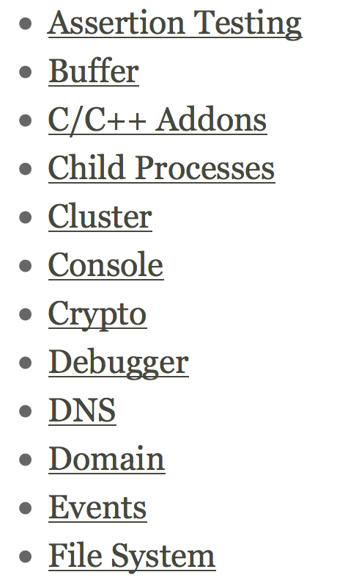
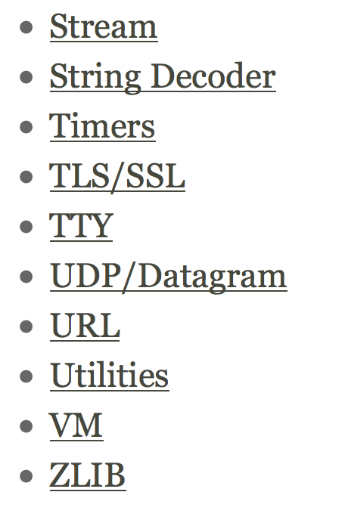

Slide 32
Let’s look at a another example
/*global require */
var http = require("http");
/**
* This function starts a http daemon on port 9000. It also
* registers a callback handler, to handle incoming HTTP
* requests (a simple message is sent back to clients).
*/
function runHttpServer() {
var server = http.createServer();
server.on("request", function (req, res) {
console.log("A request has arrived: URL=" + req.url);
res.writeHead(200, {
'Content-Type': 'text/plain'
});
res.end('Hello World\n');
});
console.log("Starting http server...");
server.listen(9000);
}
runHttpServer();
We use a standard Node module that takes care of the HTTP protocol.
Node can provide us with a ready-to-use server.
We can attach event handlers to the server. Node will notify us asynchronously, and give us access to the request and response.
We can send back data to the client.
We have wired everything, let’s welcome clients!

Slide 33
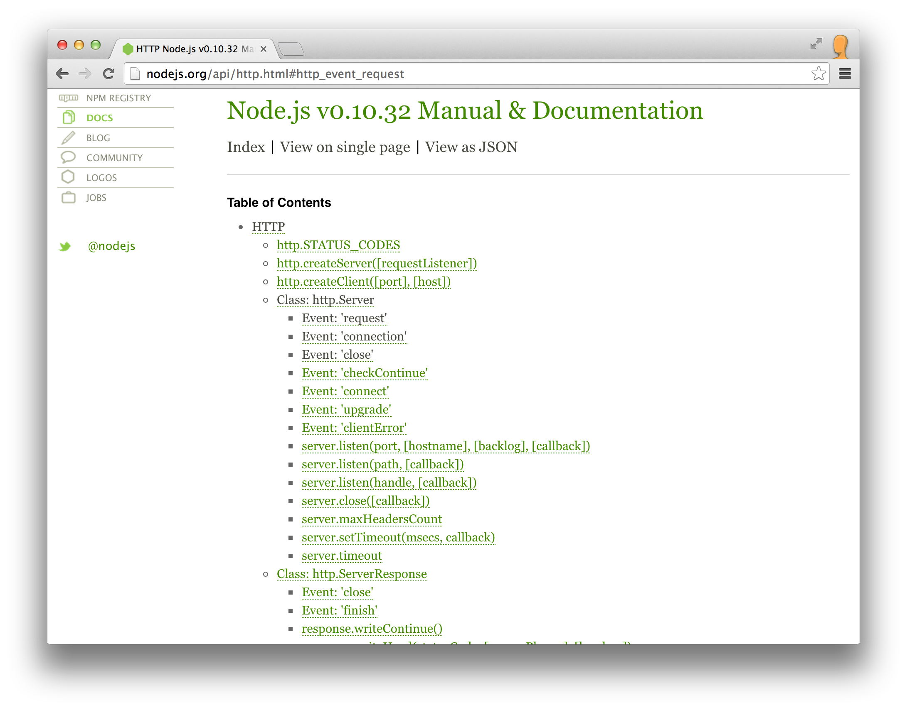
These are the events that are emitted by the class. You can write callbacks and react to these events.

Slide 34

How does Node.js use an event loop to offer an asynchronous programming model?
on(’request’, function(req, res) { // my code});
on(’data’, function(data) { // my code});
Callback functions that you have written and registered
‘request’ event
‘request’ event
Event Loop
‘data’ event
get the next event in the queue; invoke the registered callbacks in sequence; delegate I/O operations to the Node platform
‘request’ event
Queue of events that have been emitted
All the code that you write runs on a single thread
The long-running tasks (I/Os) are executed by Node in parallel; Node emits events to report progress (which triggers your callbacks).
Another pattern is to provide a callback to node when invoking an asynchronous function.

Slide 35
Node.js resources
Understanding the Node.js Event Loop
  http://strongloop.com/strongblog/node-js-event-loop/
Mixu's Node book: What is Node.js? (chapter 2)
  http://book.mixu.net/node/ch2.html
Node.js Explained, video
  http://kunkle.org/talks/

Slide 36

Node.js package manager

Slide 37

What about package management?
Not reinventing the wheel...
... building on the shoulders of giants.

Slide 38
What is npm?
”npm is the package manager for the Node JavaScript platform. It puts modules in place so that node can find them, and manages dependency conflicts intelligently.
It is extremely configurable to support a wide variety of use cases. Most commonly, it is used to publish, discover, install, and develop node programs.”
https://docs.npmjs.com/getting-started/what-is-npm

Slide 39
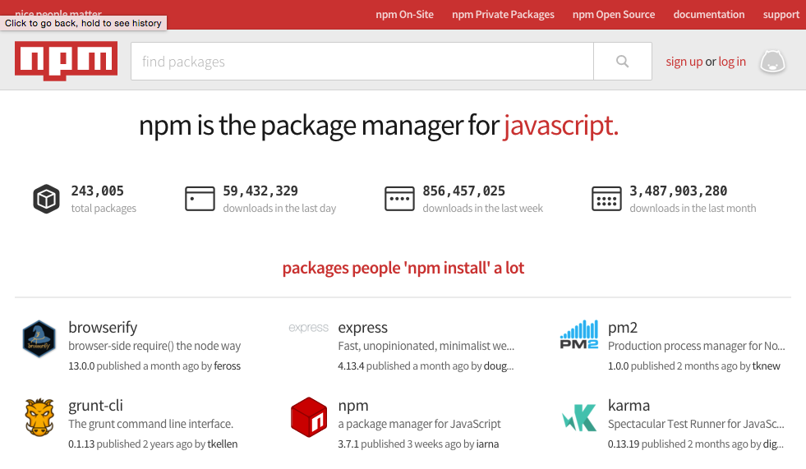
npm is a set of command line tools that work together with the node registry
https://www.npmjs.org

Slide 40
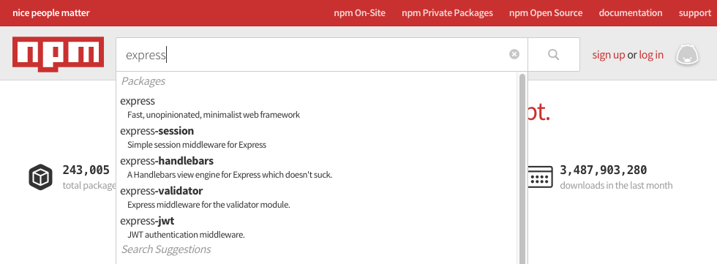
npm is a set of command line tools that work together with the node registry
https://www.npmjs.org

Slide 41
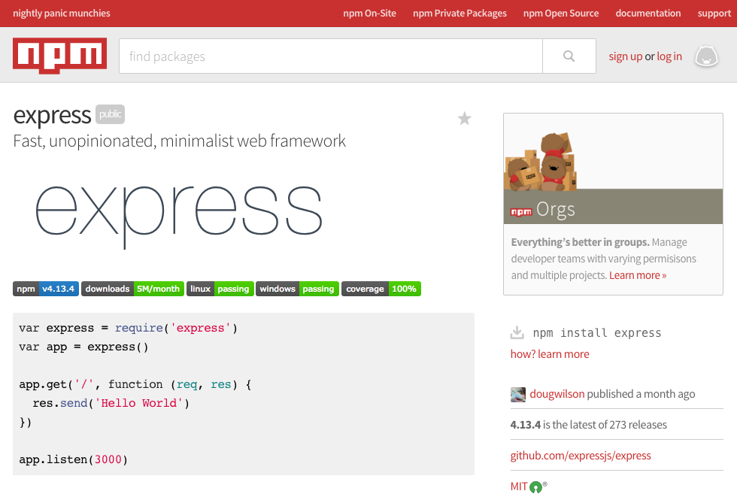
npm is a set of command line tools that work together with the node registry
https://www.npmjs.org

Slide 42
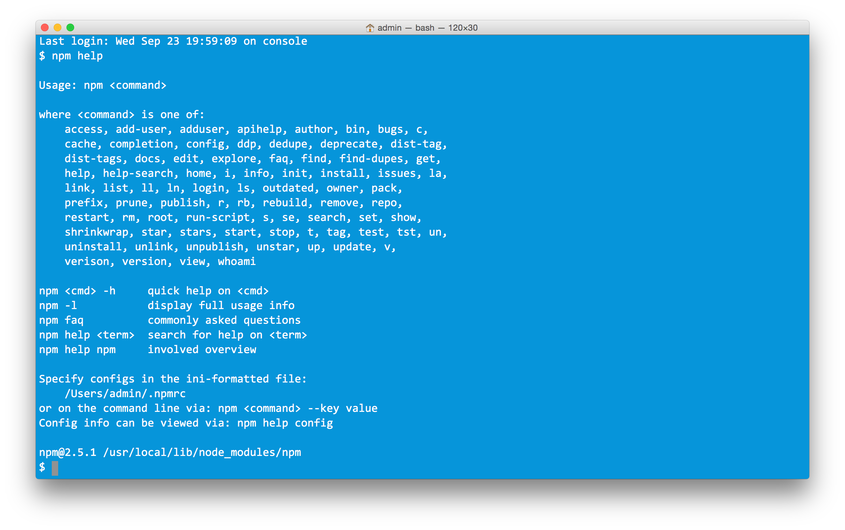


npm provides many commands
init
install
publish
update

Slide 43
npm can install packages
You can install packages with npm install [options] <name>:
  globally (this is the case for tools and CLI utilities used across projects):
    You need to use the -g flag if you want to do that (and often sudo on Unix systems).
  locally to a project (this is the case for libs that your code depends on):
    In this case, you first use npm init which will create a package.json file. This file lists the packages you use and at what versions.
    Then you can use npm install with the --save flag, which will install the latest version of the package you want and save its version to the package file.
    The modules are stored in a (often large) directory named node_modules, which you typically add to your .gitignore file.

Slide 44
How do I reuse code?
m1.js
myScript.js
module.exports.a = "b";
module.exports.hello = function() {
console.log("Hello!");
};
var module1 = require("./m1");
console.log(module1.a);
module1.hello();
var module2 = require("./m2");
module2("World");
m2.js
module.exports = function(name) {
console.log("Hello " + name + "!");
};
$> node myScript.js
b
Hello!
Hello World!
Run it!

Slide 45

How do I reuse code through npm?
Someone wrote myHello.
I want to use it in myScript.
How?

Slide 46
How do I publish myHelloModule as an npm package?
myHello/hello.js
myHello/package.json
module.exports.hello = function() {
console.log("Hello!");
};
{
"name": "myHello",
"version": "1.0.0",
"description": "My awesome module.",
"main": "./hello.js",
"repository": {
"type": "git",
"url": "https://github.com/jdoe/hello"
},
"author": "John Doe <john.doe@example.com>",
"license": "MIT"
}
Define the package:
$> cd myHelloModule
$> npm publish
Publish it!

Slide 47
How do I install myHelloModule and use it?
myScript/package.json
{
"name": "myApp",
"version": "1.0.0",
"description": "My awesome app.",
"main": "script.js",
"dependencies": {
"myHello": "1.0.0"
}
}
Add the package as a dependency to your own package:
Install dependencies:
$> npm install
myScript/script.js
Require and use the dependency:
var myHello = require("myHello");
myHello.hello();
$> node script.js
Hello!
Enjoy:

Slide 48
How do I use npm if I'm lazy?
Install the latest version of a new module and automatically save it to your package.json file:
$> npm install --save myHello
(Note: Your package.json file must already exist.)

Slide 49
npm resources
Command line usage
https://www.npmjs.org/doc/cli/npm.html
package.json format
https://docs.npmjs.com/files/package.json

